Slide 1
Promotion to professor workshop
November 2, 2022

Slide 2
AGENDA
Time in Rank
Process Review
Provost Perspective
Dean Perspective
University Committee Perspective
Views from Recently Promoted Faculty
Questions and discussion

Slide 3
speakers
Ron Fricker, Vice Provost for Faculty affairs
Julie ross, dean, College of engineering
Sheryl ball (University P&T Committee Member), Professor, Department of Economics
Harpreet Dhillon (recently promoted), Professor,
department of electrical and Computer engineering
Michael Moehler (recently promoted), professor,
department of political science
Michelle Olsen (recently promoted, professor,
school of neuroscience

Slide 4
TIME IN RANK BY GENDER
% DISTRIBUTION OF TIME IN RANK FOR PROMOTIONS TO PROFESSOR SINCE 2000
(Individuals promoted from Associate Professor to Professor at Virginia Tech)
WOMEN
Average Years
in Rank
8.64
Median Years
in Rank
7.00
MEN
Average Years
in Rank
7.91
Median Years
in Rank
7.00

Slide 5
PROMOTION TO PROFESSOR SUCCESS 2012-2022

Slide 6
PROMOTION AND TENURE PROCESS
Department Level
College Level
University Level
Dossier
P&T Comm
Head
P&T Comm
Dean
P&T Comm
Provost
External Letters
BOV
President
Notes:
PROMOTION AND TENURE SCHEDULE
April/May Departments evaluate candidates for promotion
June External reviewers selected and invited
July/August Dossiers completed and sent to external reviewers
October Department committee and head review
November Dossiers sent to college
Dec/Jan College committee and dean review
Jan/Feb Dossiers submitted to Provost office from colleges
Materials distributed to university committee
March/April University committee and provost review
April Provost makes recommendations to President
June President submits recommendations to BOV
BOV approval – faculty notified
Sept/Oct Reception for promoted faculty

Slide 7
DEPARTMENTAL/COMMITTEE RESPONSIBILTIES
External reviewers should be chosen by department committee/department head, with minority suggested by candidate
External reviewers should be professors from competitive and aspirational peer universities and appropriate other institutions (e.g., government)
Department head’s letter should address the expectations for the candidate’s promotion in the context of departmental standards and candidate’s assignment in:
Research, scholarship and/or creative achievements
Teaching and instruction
Service and outreach
Committee letters should address major points of discussion, both positive and negative
All letters should address major points emphasized by external reviewers

Slide 8
KEY RESOURCES
Colleagues
Professors in your department/school
Department head, chair, or school director
Members of the departmental P&T committee
Mentors and other professional colleagues
References
Faculty Handbook, chapter 3
Provost’s website
Promotion and Tenure Guidelines
Dossier Template and Cover Page
College and/or departmental expectations and procedural documents

Slide 9
PROVOST’S PERSPECTIVE
Promotion to professor reserved for those whose achievements are broad and noteworthy
National and/or international distinction and leadership
Excellence in research, scholarship, and/or creative achievement
High level of competence in instruction, outreach, and service
Faculty Handbook (section 3.1.3):
“…appointment to the rank of professor is contingent on national or international recognition as an outstanding scholar and educator.”

Slide 10
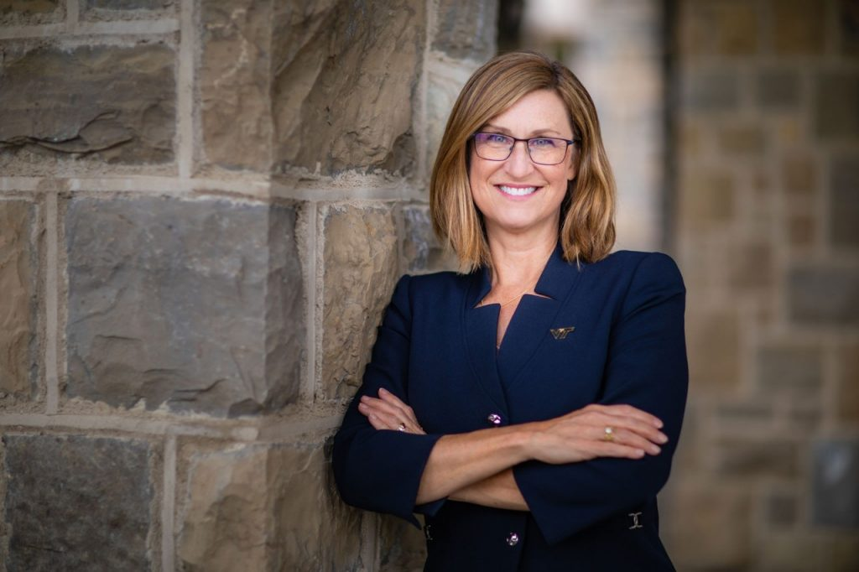
Dean’s PERSPECTIVE
Julie Ross
College of Engineering

Slide 11
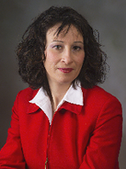
University committee PERSPECTIVE
Sheryl Ball
Professor, Department of Economics

Slide 12
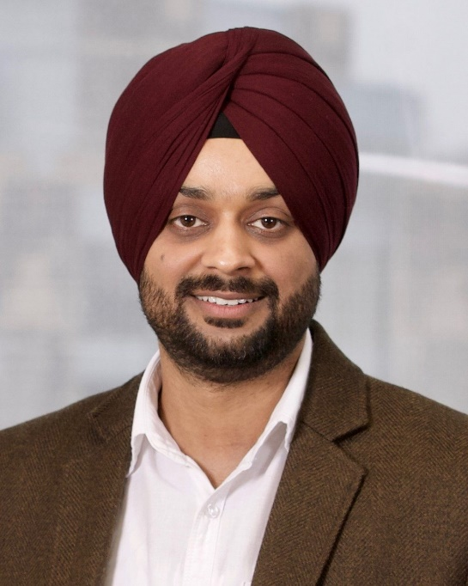
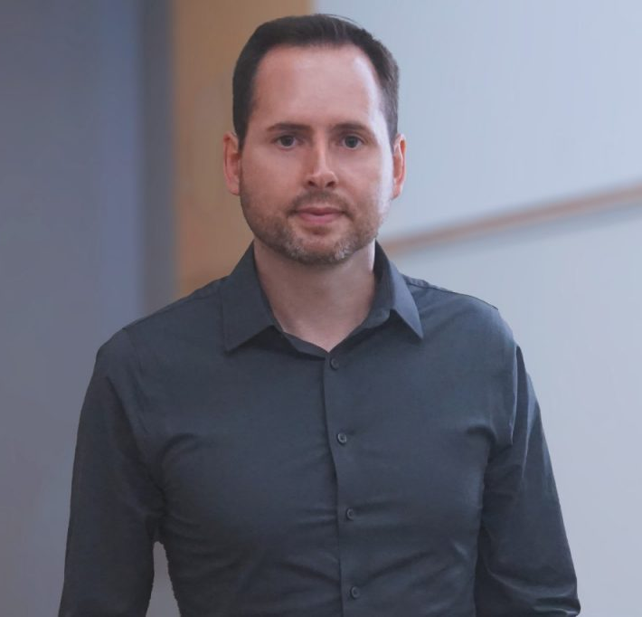
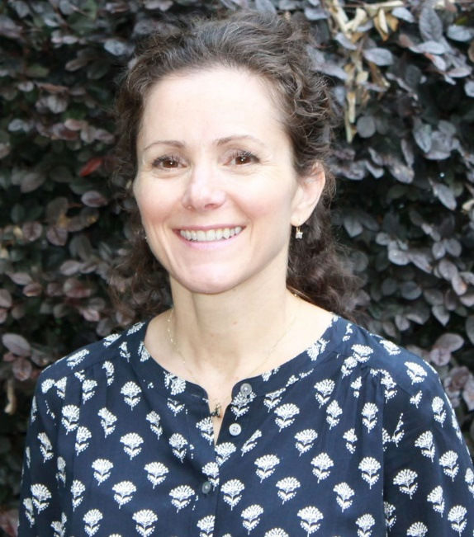
PERSPECTIVEs from recently promoted faculty
Harpreet Dhillon, Professor
Department of Electrical and Computer Engineering
Michael Moehler, Professor
Department of Political Science
and Kellogg Center for Philosophy, Politics, and Economics
Michelle Olsen, Professor
School of Neuroscience

Slide 13
Questions and discussion
Visit the Promotion and Tenure website for more information:
https://faculty.vt.edu/promotion-tenure.html

